Slide 1

Intergovernmental Panel on Climate Change (IPCC)
Established 1988
Co-sponsored by World Meteorological Organization (WMO) and United Nations Environment Programme (UNEP)
Working Group I (the physical science basis)
Working Group II (impacts, adaptation and vulnerability)
Working Group III (mitigation)
Assessment reports: 1990 (FAR), 1995 (SAR), 2001 (TAR), 2007 (AR4), 2014 (AR5)

Slide 2
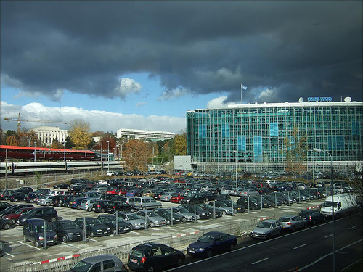
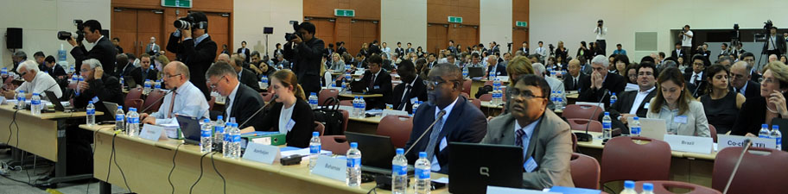
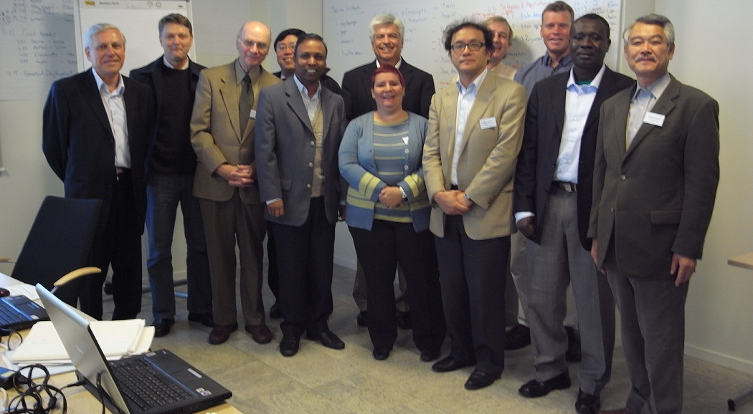





A Scientific and Intergovernmental Body
The Secretariat
2) The Panel
3) The Bureau
4) The Authors
5) The Technical Support Units

Slide 3
The process
IPCC reports drafted by international teams of scientists, 3 components:
    Full report
    Technical Summary
    Summary for Policymakers (SPM)
Undergo expert and government review
Full report Accepted by member governments
SPM Approved line-by-line (word-by-word) during an intergovernmental meeting

Slide 4
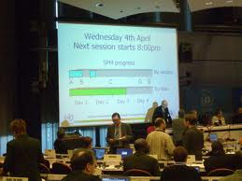
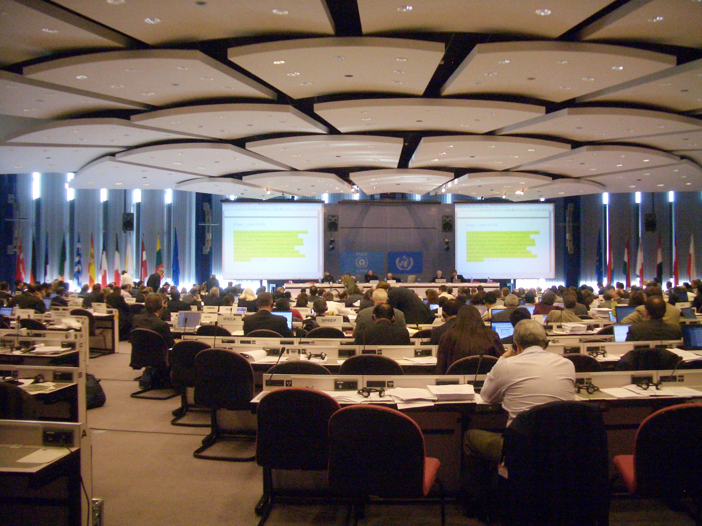
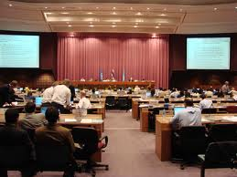
A report approval session

Slide 5
An Intergovernmental Meeting
Objective: for governments to accept and approve the latest scientific, socio-economic and environmental knowledge of the climate change problematic, its impacts, adaptation and possible mitigation strategies
Problem: Governments have different interests in climate change and the knowledge they accept and approve has the potential to impact their negotiating position within the UN Framework Convention on Climate Change (UNFCCC)

Slide 6
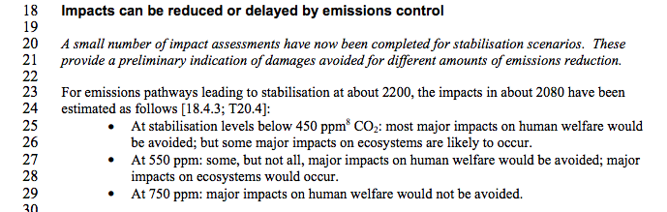
The IPCC seminar
6 countries + an SPM text to approve:
    Brazil
    China
    EU
    Russia
    Saudi Arabia
    USA
Your task: What are your country’s/region’s interests in the climate change problematic?
What is your country’s contribution to global Greenhouse Gas Emissions (GHGs)?
How will IPCC knowledge impact these interests?
Do you want stronger conclusions or weaker conclusions?
Do you want to talk about Mitigation? Financing adaptation? Developing versus Developed? Carbon Dioxide? Methane? Or other GHGs?

Slide 7
The Task
  Read texts provided and conduct further research on your country/region’s interests in climate change and attitude towards the international negotiating process. Remember
      Some country’s interests have remained constant, whilst others have changed over time, depending on: type of government in power, cost of reducing emissions, impacts of climate change, perceived advantages of responding/engaging with international process, level of development.
How are these interests likely to effect the country’s attitude towards the SPM text during the approval session?
Opening statement + negotiation of text
Meeting to discuss/clarify delegation’s position: 7th May
Seminar: 14th May 10:00-12:00

Slide 8
7th May meeting times
12:30-1:00 Saudi Arabia
1:00-1:30 China
3:00-3:30 Brazil
3:30-4:00 USA
4:00-4:30 EU
4:30-5:00 Russia

